Slide 1
Basic Concepts.
Naïve Bayes.
Performance Metrics.
Radu Ionescu, Prof. PhD.
raducu.ionescu@gmail.com
Faculty of Mathematics and Computer Science
University of Bucharest

Slide 2
Learning paradigms
Standard learning paradigms:
Supervised learning
Unsupervised learning
Semi-supervised learning
Reinforcement learning
Non-standard paradigms:
Active learning
Transfer learning
Transductive learning

Slide 3
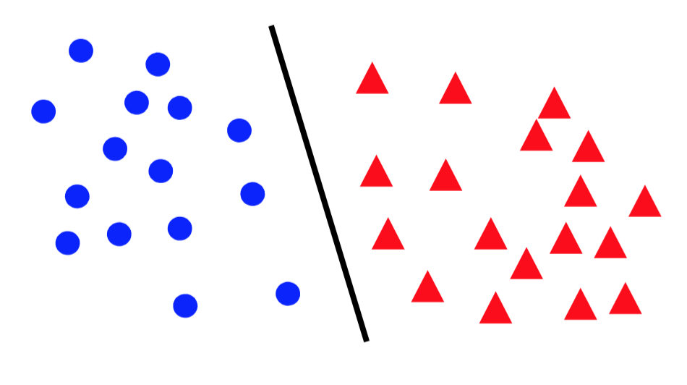
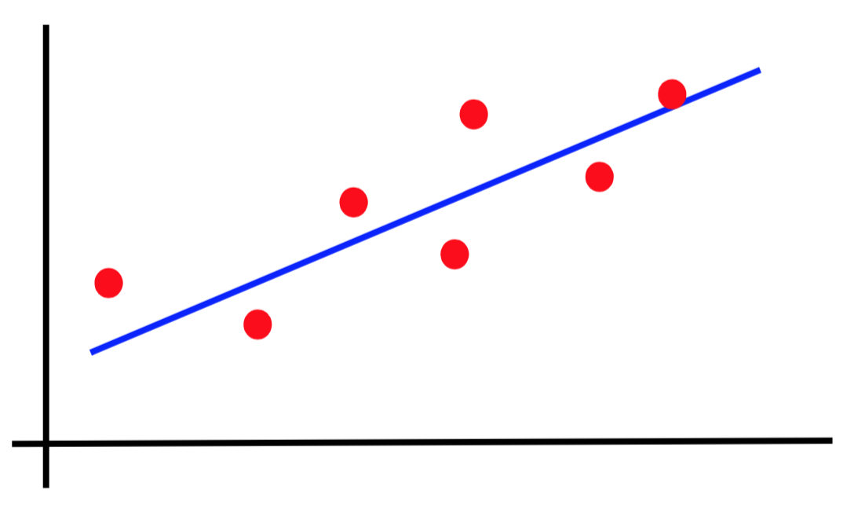
Canonical forms of supervised learning problems
Classification
Regression

Slide 4
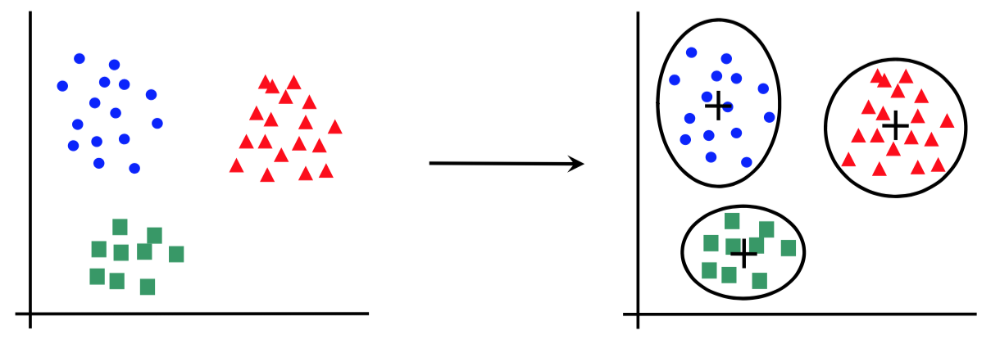
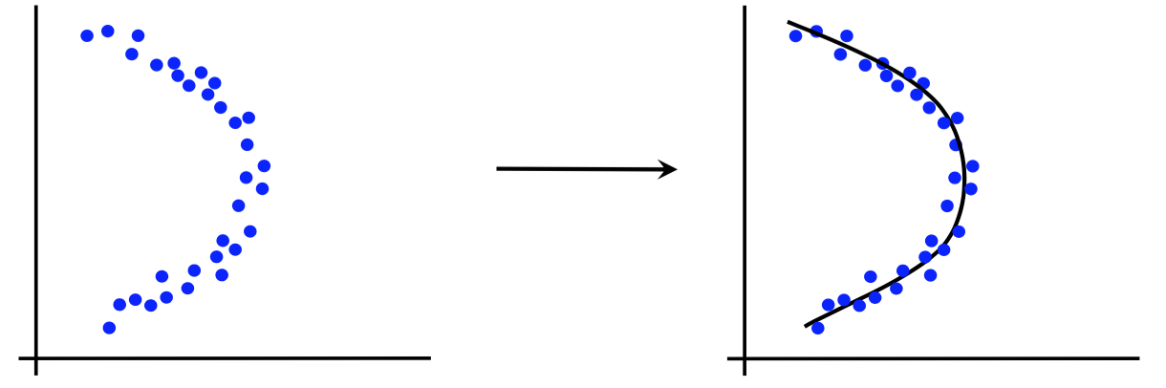
Canonical forms of unsupervised learning problems
Clustering
Dimensionality Reduction

Slide 5
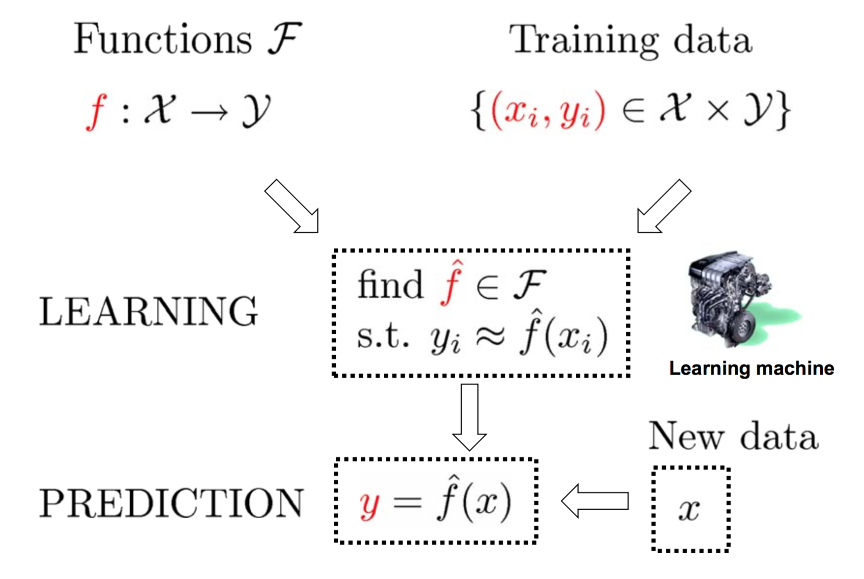
The supervised learning paradigm

Slide 6
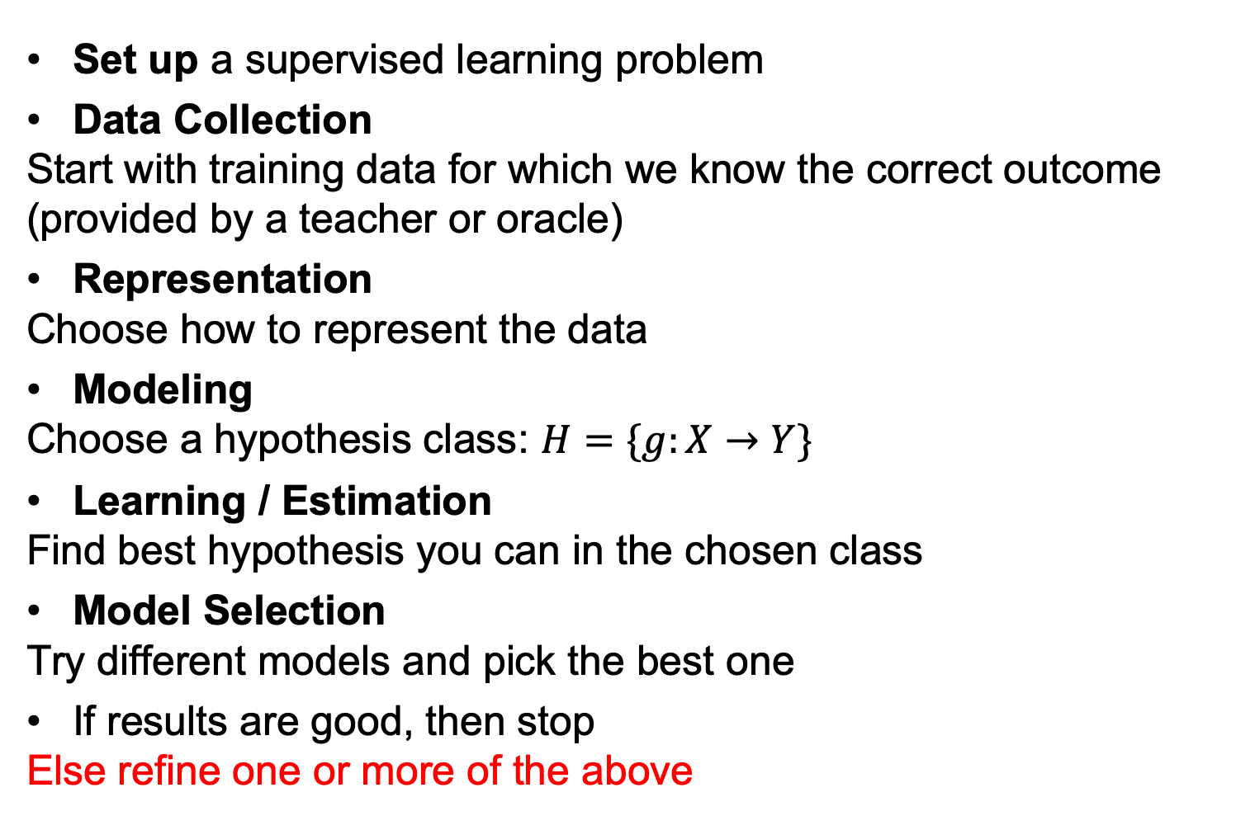
Basic Steps of Supervised Learning
Set up a supervised learning problem
Data Collection
Start with training data for which we know the correct outcome (provided by a teacher or oracle)
Representation
Choose how to represent the data
Modeling
Choose a hypothesis class: $H=\{g:X→Y\}$
Learning / Estimation
Find best hypothesis you can in the chosen class
Model Selection
Try different models and pick the best one
If results are good, then stop
Else refine one or more of the above

Slide 7


Classification into Banana or Furbish
Training data
Banana language:
baboi, bananonina, bello, hana, stupa
Furbish:
doo, dah, toh, yoo, dah-boo, ee-tay
Test data
gelato
What is the language?
Why?
Learning is hard without establishing the hypothesis class!

Slide 8
Training versus Testing
What do we want?
Good performance (low loss) on training data?
No, good performance on unseen test data!
Training Data:
{(x₁,y₁), (x₂,y₂), …, (x_{N},y_{N})}
Given to us for learning the mapping function f
Test Data:
{x₁, x₂, …, x_{M}}
Used to see if we have learnt anything 🙈

Slide 9
Loss / Error Functions
How do we measure performance?
Regression:
Mean Squared Error (MSE)
Mean Absolute Error (MAE)
Classification:
Misclassification rate
Weighted misclassification rate via a cost matrix
Binary classification:
True Positive, False Positive, True Negative, False Negative
Multi-class classification:
Confusion Matrix

Slide 10
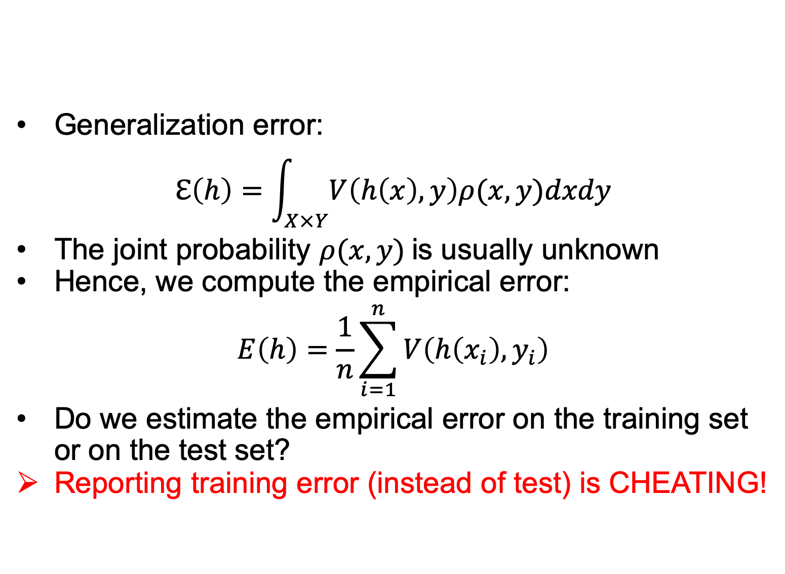
Errors
Generalization error:
$$ℇ\left(h\right)=\int_{X×Y}{V\left(h\left(x\right),y\right)ρ(x,y)dxdy}$$
The joint probability $ρ(x,y)$is usually unknown
Hence, we compute the empirical error:
$$E\left(h\right)=\frac{1}{n}\sum_{i=1}^{n}{V\left(h\left(x_{i}\right), y_{i}\right)}$$
Do we estimate the empirical error on the training set or on the test set?
Reporting training error (instead of test) is CHEATING!

Slide 11
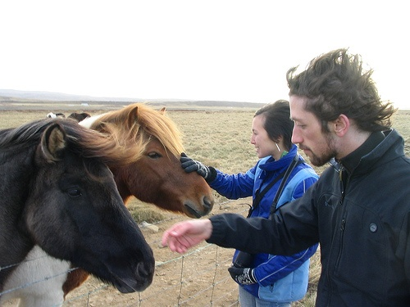
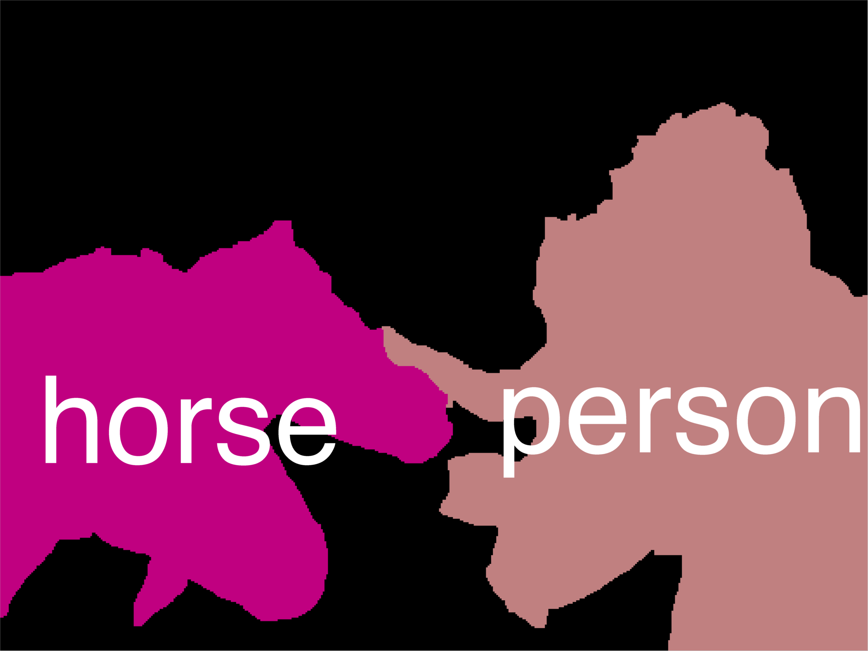
Error Decomposition
Reality
Modeling Error
Estimation Error
Optimization Error
Hypothesis class

Slide 12
Error Decomposition
Approximation/Modeling Error
We approximate the reality with a model (hypothesis class)
Estimation Error
We try to learn a model with finite data
Optimization Error
We could/did not optimize to completion
Bayes Error (more on this later)
Reality just sucks!

Slide 13
Bias-Variance Trade-off
Bias
Systematic error that comes from the inability of the model to learn the true relationship between features and labels (underfitting)
Can be corrected by increasing the model’s complexity
Variance
Random error that comes from sensitivity to small fluctuations in the data, because the algorithm modeled noise in the training data (overfitting)
Can be corrected by adding more training samples or by decreasing the model’s complexity

Slide 14
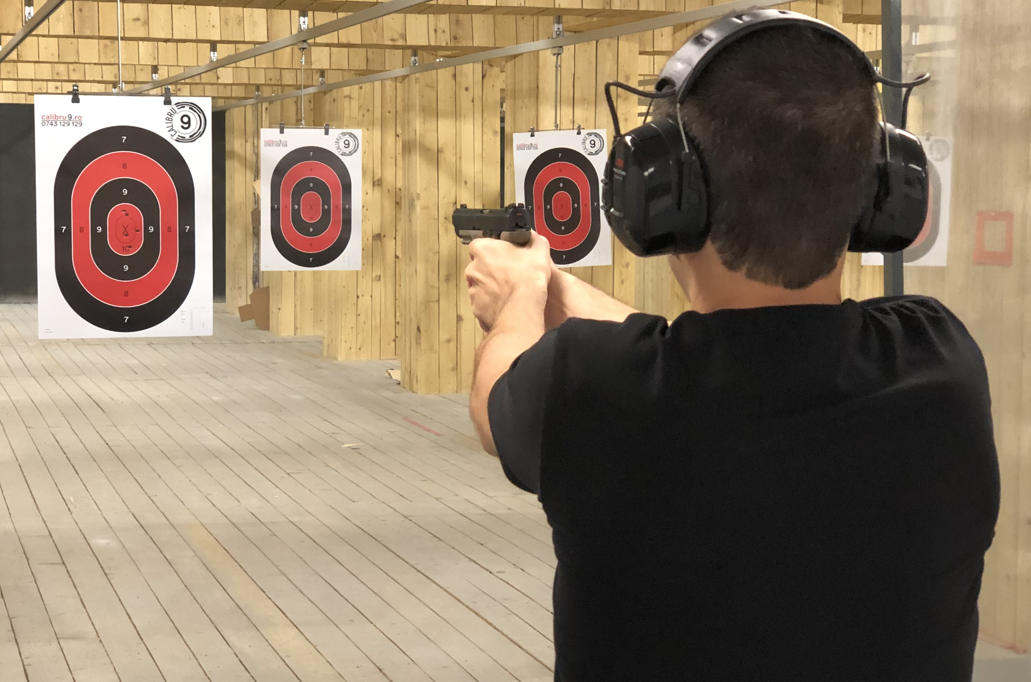
Bias-Variance Trade-off

Slide 15
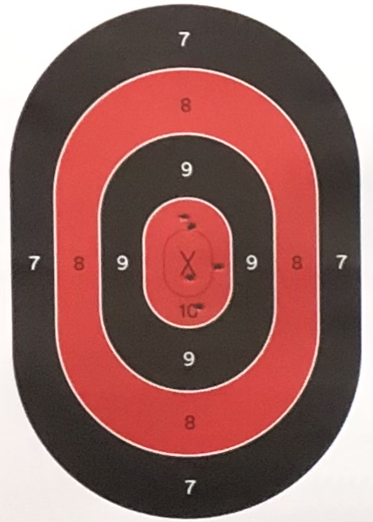
Bias-Variance Trade-off
Low Bias
High Bias
Low Variance
High Variance

Slide 16
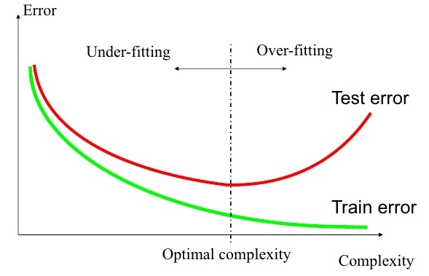
Underfitting versus overfitting
Perhaps the most important problem of learning?
All about improving generalization capacity

Slide 17
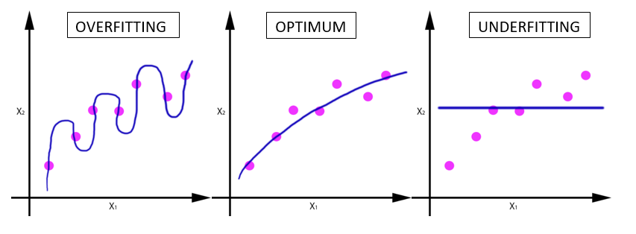
Underfitting versus overfitting
Example 1: regression task

Slide 18
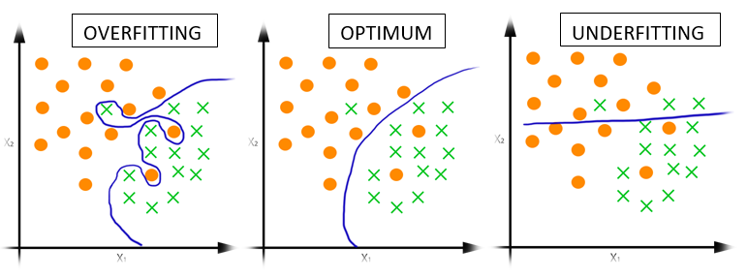
Underfitting versus overfitting
Example 2: classification task

Slide 19
Procedural View
Training Stage:
Raw data → x
(feature extraction)
Training data {(x, y)} → f
(learning)
Testing Stage:
Raw data → x
(feature extraction)
Test data x → f(x)
(apply function, evaluate error)

Slide 20
Statistical Estimation View
Probabilities to the rescue:
x and y are random variables
D = (x₁,y₁), (x₂,y₂), …, (x_{N},y_{N}) ~ P(X,Y)
We suppose that data is IID (Independent Identically Distributed):
Both training and test data sampled IID from P(X,Y)
Learn on training set
Have some hope of generalizing to test set

Slide 21
Important Concepts
Model capacity
Measure how large hypothesis class H is?
Are all functions allowed?
Overfitting
f works well on training data
Works poorly on test data
Generalization capacity
The ability to achieve low error on new test data

Slide 22
Guarantees
20 years of research in Learning Theory oversimplified…
If we have:
enough training data D
and H is not too complex
then probably we can generalize to unseen test data

Slide 23
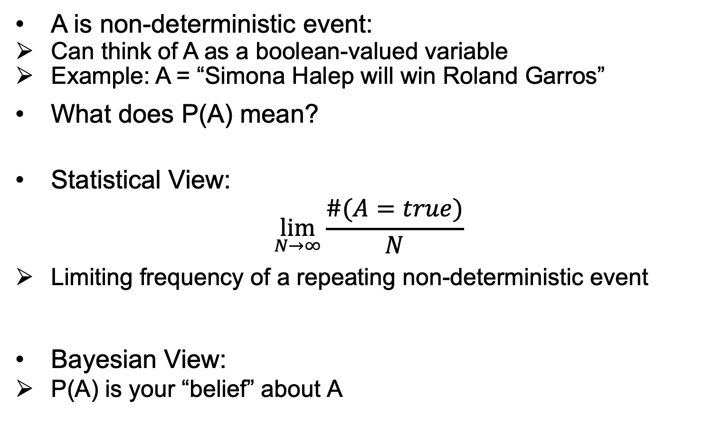
Probabilities (recap)
A is non-deterministic event:
Can think of A as a boolean-valued variable
Example: A = “Simona Halep will win Roland Garros”
What does P(A) mean?
Statistical View:
$$\lim_{N→∞}{\frac{\#(A=true)}{N}}$$
Limiting frequency of a repeating non-deterministic event
Bayesian View:
P(A) is your “belief” about A

Slide 24
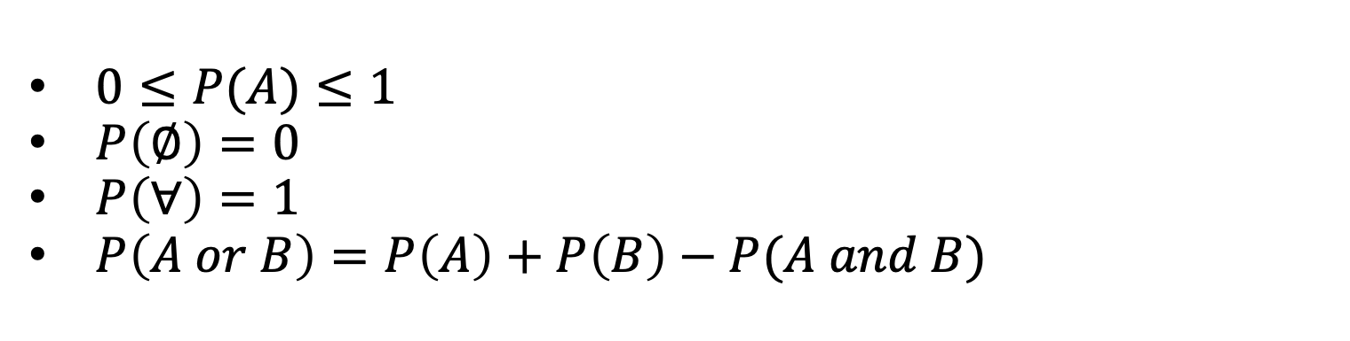
Axioms of Probability (recap)
$0≤P(A)≤1$
$P\left(∅\right)=0$
$P\left(∀\right)=1$
$P\left(A or B\right)=P\left(A\right)+P\left(B\right)−P(A and B)$
A or B
A and B
B
A

Slide 25
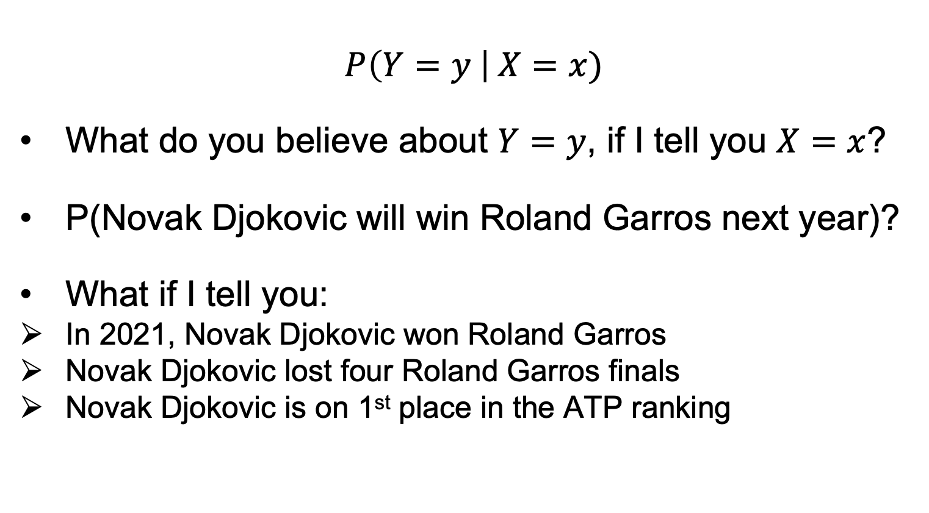
Conditional Probabilities (recap)
$$P\left(Y=y \right| X=x)$$
What do you believe about $Y=y$, if I tell you $X=x$?
P(Novak Djokovic will win Roland Garros next year)?
What if I tell you:
In 2021, Novak Djokovic won Roland Garros
Novak Djokovic lost four Roland Garros finals
Novak Djokovic is on 1st place in the ATP ranking

Slide 26
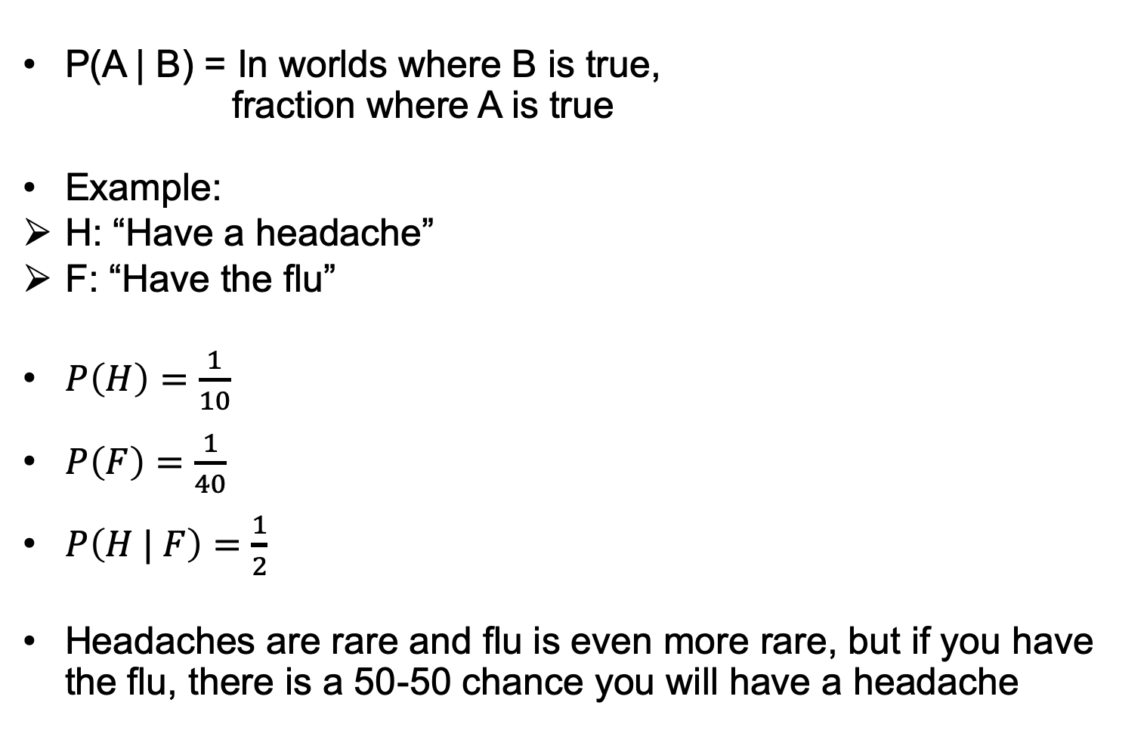
Conditional Probabilities (recap)
P(A | B) = In worlds where B is true, fraction where A is true
Example:
H: “Have a headache”
F: “Have the flu”
$P\left(H\right)=\frac{1}{10}$
$P\left(F\right)=\frac{1}{40}$
$P\left(H | F\right)=\frac{1}{2}$
Headaches are rare and flu is even more rare, but if you have the flu, there is a 50-50 chance you will have a headache
F
H

Slide 27

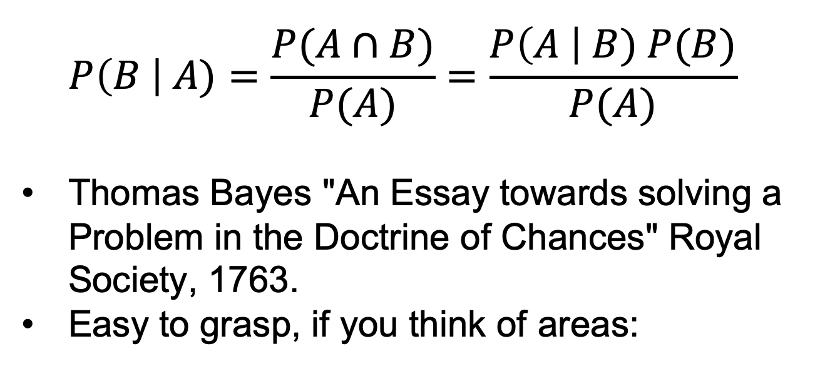
Bayes Rule
$$P\left(B \right| A)=\frac{P(A∩B)}{P(A)}=\frac{P\left(A \right| B) P(B)}{P(A)}$$
Thomas Bayes "An Essay towards solving a Problem in the Doctrine of Chances" Royal Society, 1763.
Easy to grasp, if you think of areas:
B
A

Slide 28
Bayes Rule
Concepts:
Likelihood
How much does a certain hypothesis explain the data?
Prior
What do you believe before seeing any data?
Posterior
What do we believe after seeing the data?

Slide 29
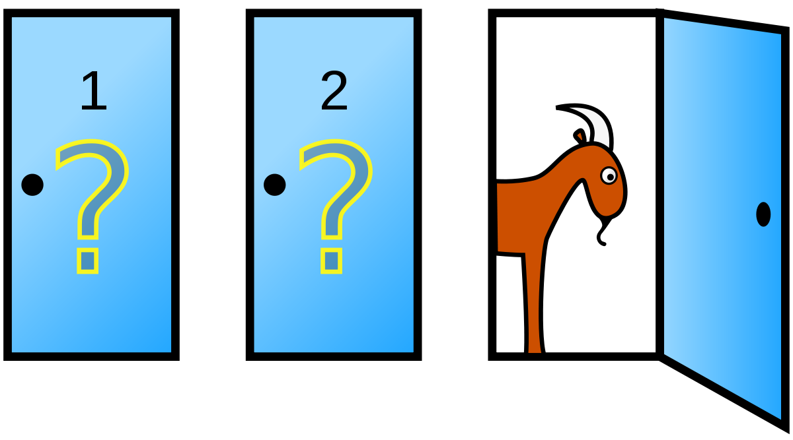
Monty Hall Problem
There are 3 doors numbered with 1, 2, 3.
A large prize (a car) is hidden behind one of the doors. The other doors each have a goat behind.
We have to pick a door.
Suppose that we opt for door 1. Then, the host opens door 3, revealing the goat behind. We are offered the option to change our pick. What should we do next?
(a) We keep our initial choice (door 1);
(b) We switch to door 2;
(c) There is no difference.

Slide 30
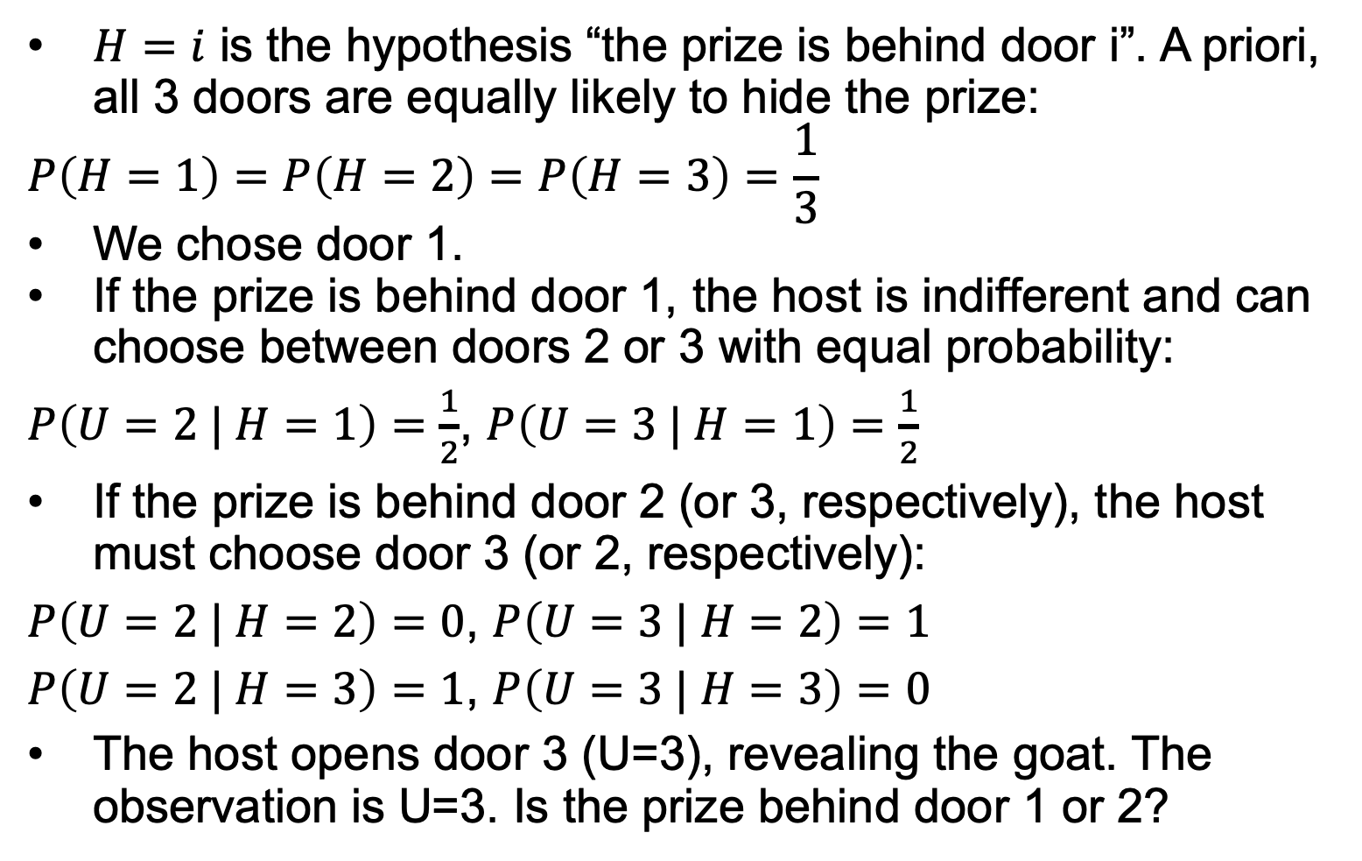
Monty Hall Problem
$H=i$ is the hypothesis “the prize is behind door i”. A priori, all 3 doors are equally likely to hide the prize:
$$P\left(H=1\right)=P\left(H=2\right)=P\left(H=3\right)=\frac{1}{3}$$
We chose door 1.
If the prize is behind door 1, the host is indifferent and can choose between doors 2 or 3 with equal probability:
$P\left(U=2 | H=1\right)=\frac{1}{2}$, $P\left(U=3 | H=1\right)=\frac{1}{2}$
If the prize is behind door 2 (or 3, respectively), the host must choose door 3 (or 2, respectively):
$P\left(U=2 | H=2\right)=0$, $P\left(U=3 | H=2\right)=1$
$P\left(U=2 | H=3\right)=1$, $P\left(U=3 | H=3\right)=0$
The host opens door 3 (U=3), revealing the goat. The observation is U=3. Is the prize behind door 1 or 2?

Slide 31
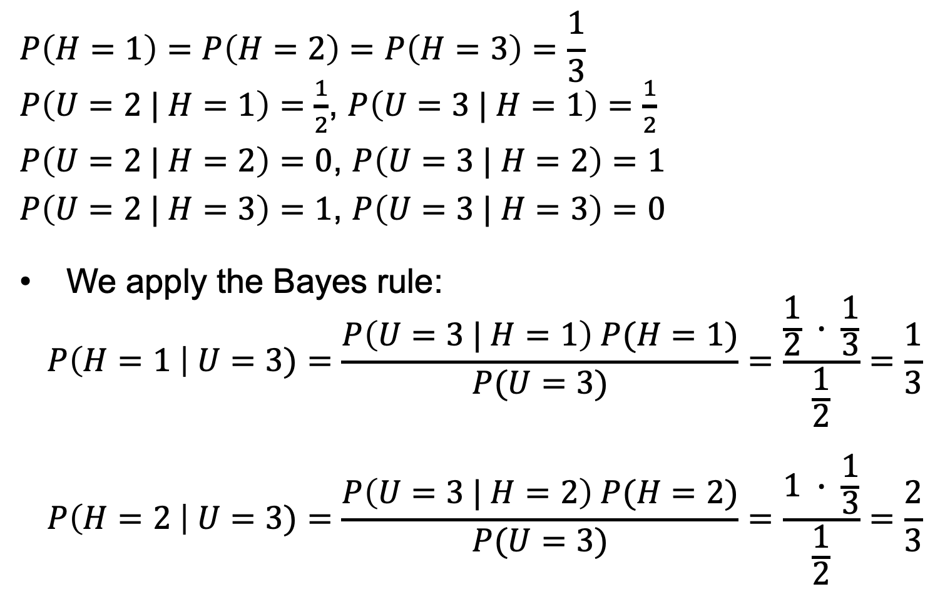
Monty Hall Problem
$$P\left(H=1\right)=P\left(H=2\right)=P\left(H=3\right)=\frac{1}{3}$$
$P\left(U=2 | H=1\right)=\frac{1}{2}$, $P\left(U=3 | H=1\right)=\frac{1}{2}$
$P\left(U=2 | H=2\right)=0$, $P\left(U=3 | H=2\right)=1$
$P\left(U=2 | H=3\right)=1$, $P\left(U=3 | H=3\right)=0$
We apply the Bayes rule:
$$P\left(H=1 \right| U=3)=\frac{P\left(U=3 | H=1\right) P(H=1)}{P(U=3)}=\frac{\frac{1}{2} ∙ \frac{1}{3}}{\frac{1}{2}}=\frac{1}{3}$$
$$P\left(H=2 \right| U=3)=\frac{P\left(U=3 | H=2\right) P(H=2)}{P(U=3)}=\frac{1 ∙ \frac{1}{3}}{\frac{1}{2}}=\frac{2}{3}$$

Slide 32
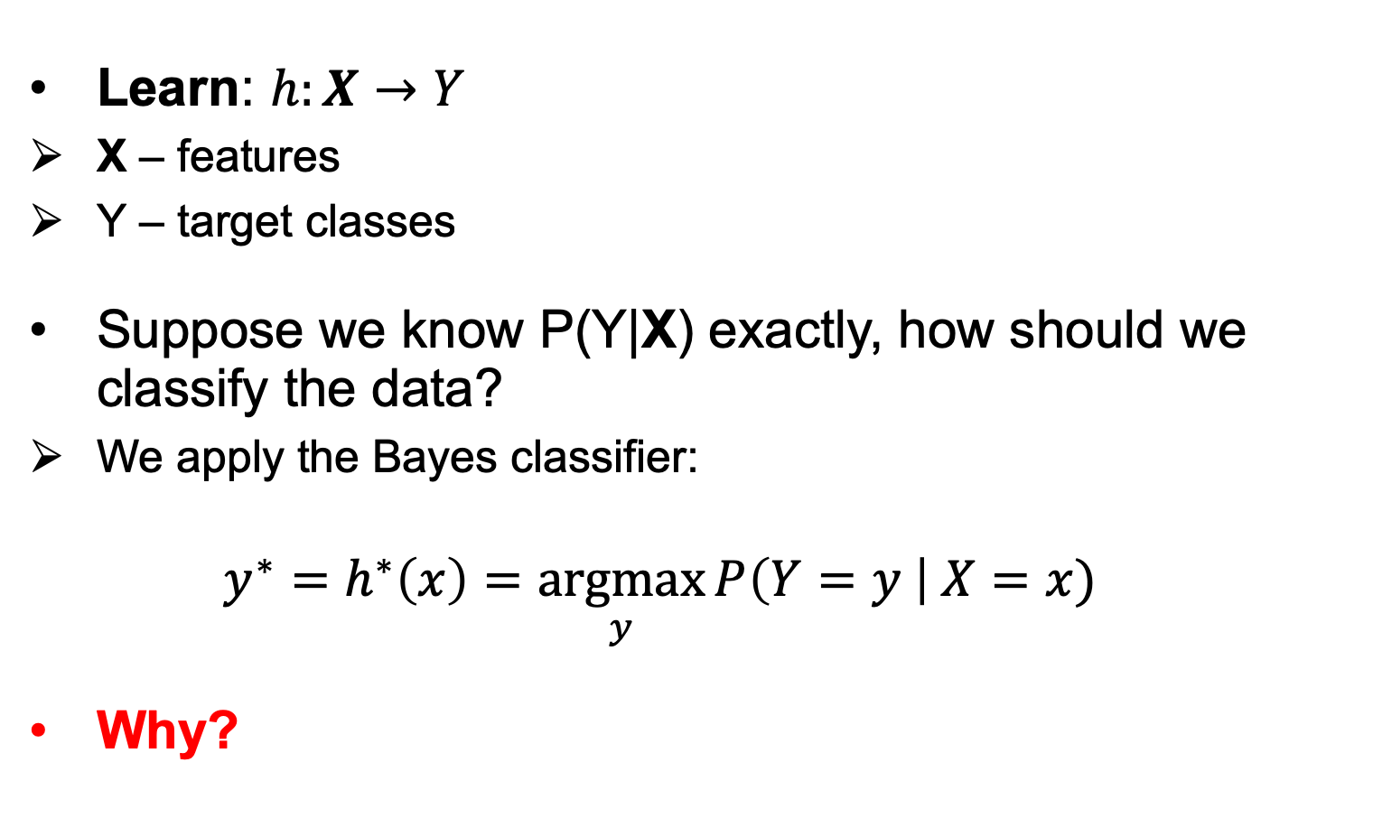
Optimal classifier
Learn: $h:X→Y$
X – features
Y – target classes
Suppose we know P(Y|X) exactly, how should we classify the data?
We apply the Bayes classifier:
$$y^{∗}=h^{∗}\left(x\right)=\underset{y}{argmax}{P\left(Y=y \right| X=x) }$$
Why?

Slide 33
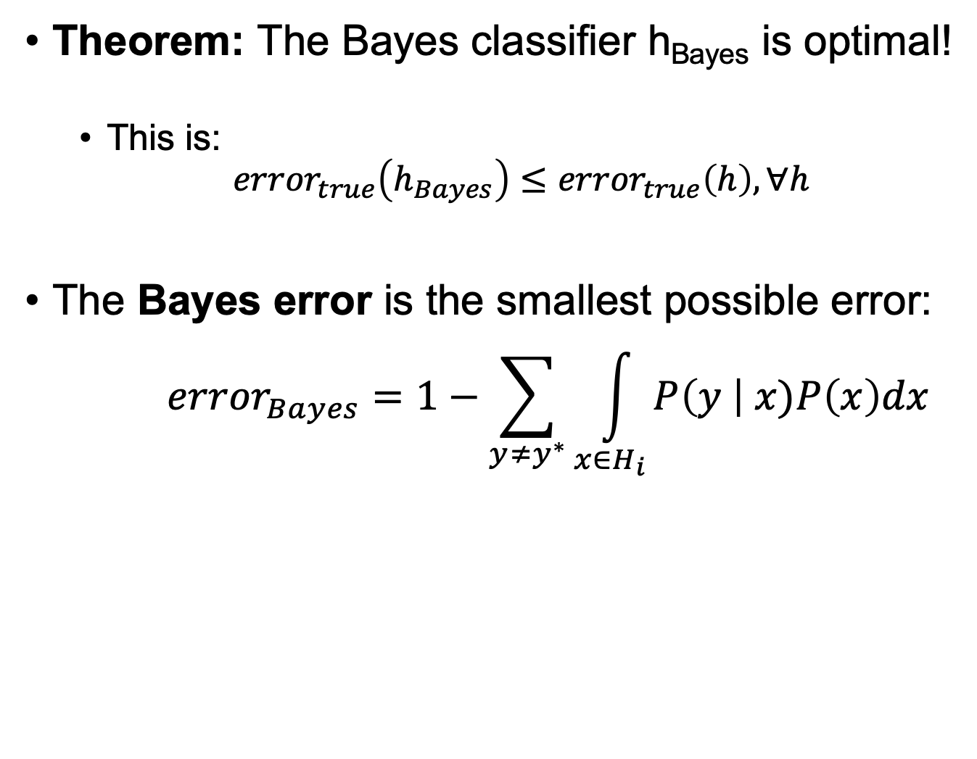
Optimal classifier
Theorem: The Bayes classifier h_{Bayes} is optimal!
This is:
$${error}_{true}\left(h_{Bayes}\right)≤{error}_{true}\left(h\right),∀h$$
The Bayes error is the smallest possible error:
$${error}_{Bayes}=1−\sum_{y≠y^{∗}}{\int_{x∈H_{i}}{P\left(y \right| x)P\left(x\right)dx}}$$

Slide 34
Optimal classifier
How hard is it to learn the optimal classifier?
What about categorical data?
How do we represent these? How many parameters?
Class-Prior P(Y):
Suppose Y is composed of k classes
Likelihood P(X | Y):
Suppose X is composed of n binary features
Complex model → High variance with limited data!

Slide 35

Independence to the rescue
Two variables are independent iif their joint factors:
$$P\left(x,y\right)=P\left(x\right) P(y)$$
Two variables are conditionally independent if, given a third variable, we have:
$$P\left(x,y \right| z)=P\left(x \right| z) P\left(y \right| z)$$
 | P(x,y) |  |  |  |  |  |  |  | P(x)
 |  |  | = |  |  |  | x
 |  |  |  |  |  | P(y)

Slide 36
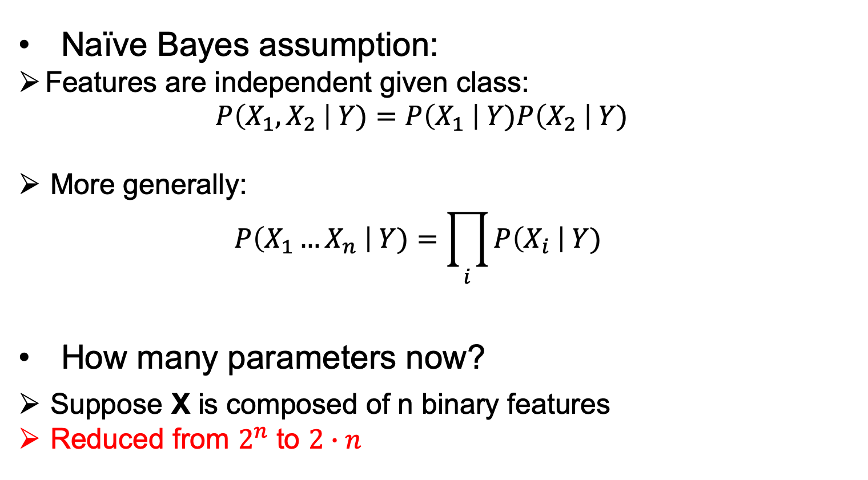
Naïve Bayes assumption
Naïve Bayes assumption:
Features are independent given class:
$$P\left(X_{1},X_{2} \right| Y)=P\left(X_{1} \right| Y)P\left(X_{2} \right| Y)$$
More generally:
$$P\left(X_{1}…X_{n} \right| Y)=\prod_{i}{P\left(X_{i} \right| Y) }$$
How many parameters now?
Suppose X is composed of n binary features
Reduced from $2^{n}$ to $2∙n$

Slide 37
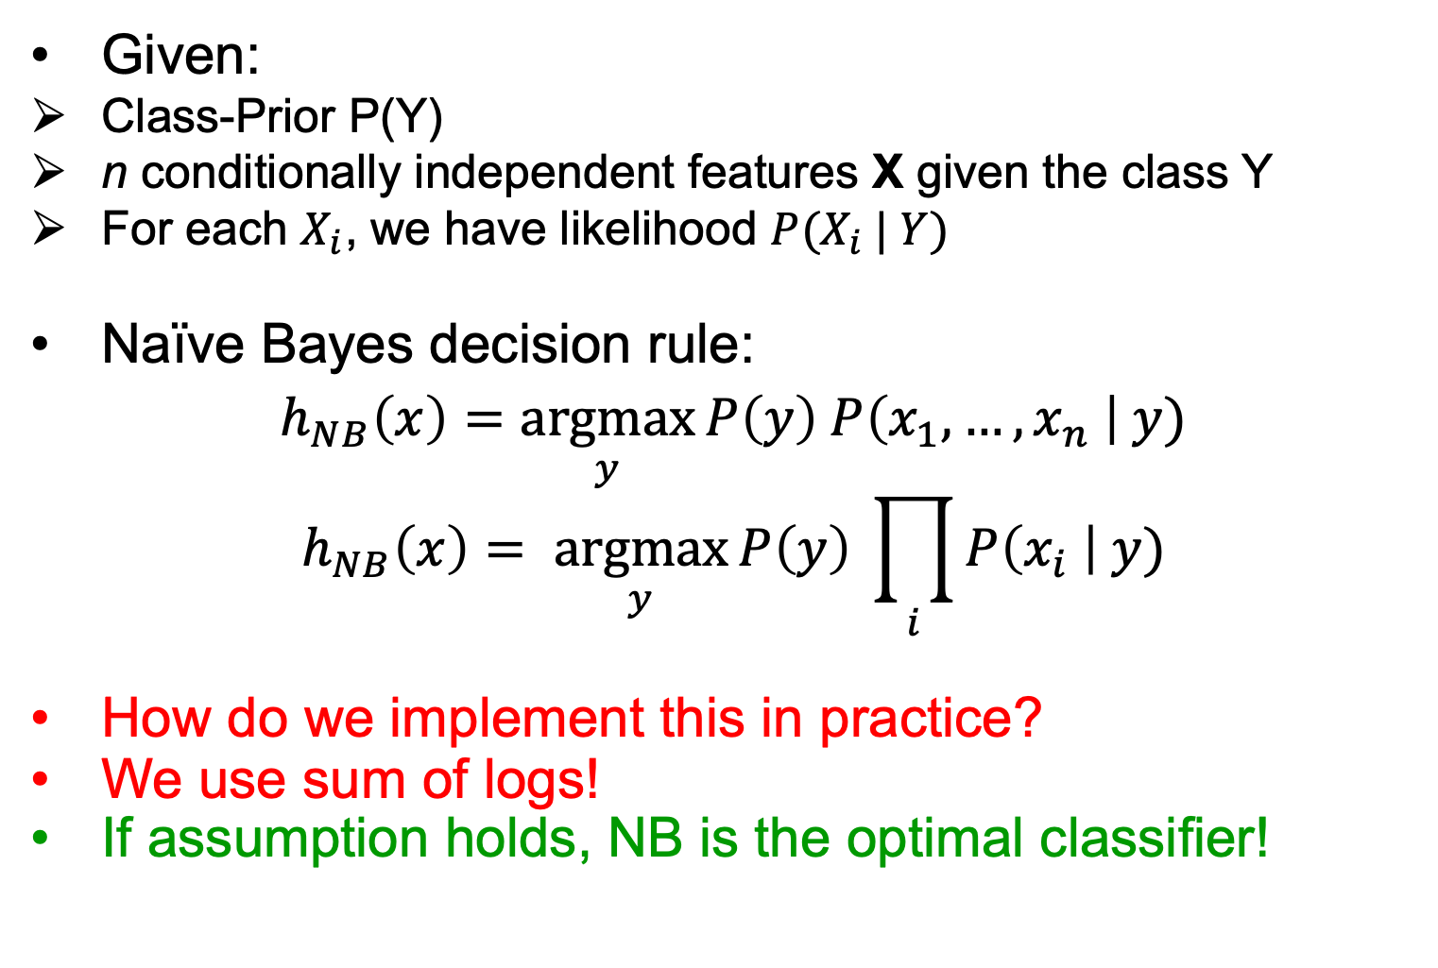
Naïve Bayes classifier
Given:
Class-Prior P(Y)
n conditionally independent features X given the class Y
For each $X_{i}$, we have likelihood ${P(X}_{i} | Y)$
Naïve Bayes decision rule:
$$h_{NB}\left(x\right)=\underset{y}{argmax}{P\left(y\right) P\left(x_{1},…,x_{n} \right| y)}$$
$$h_{NB}\left(x\right)= \underset{y}{argmax}{P\left(y\right) \prod_{i}{P\left(x_{i} \right| y)}}$$
How do we implement this in practice?
We use sum of logs!
If assumption holds, NB is the optimal classifier!

Slide 38
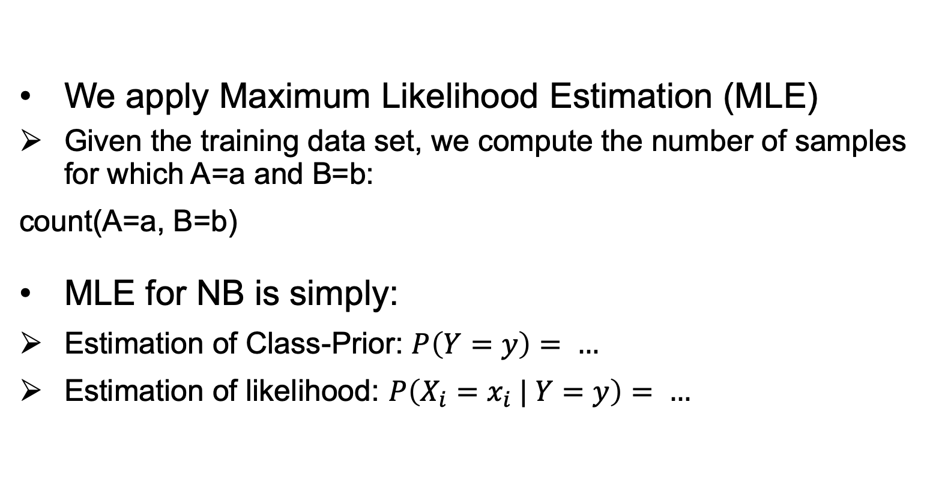
Estimating parameters of NB
We apply Maximum Likelihood Estimation (MLE)
Given the training data set, we compute the number of samples for which A=a and B=b:
count(A=a, B=b)
MLE for NB is simply:
Estimation of Class-Prior: $P\left(Y=y\right)= …$
Estimation of likelihood: $P\left(X_{i}=x_{i} | Y=y\right)= …$

Slide 39
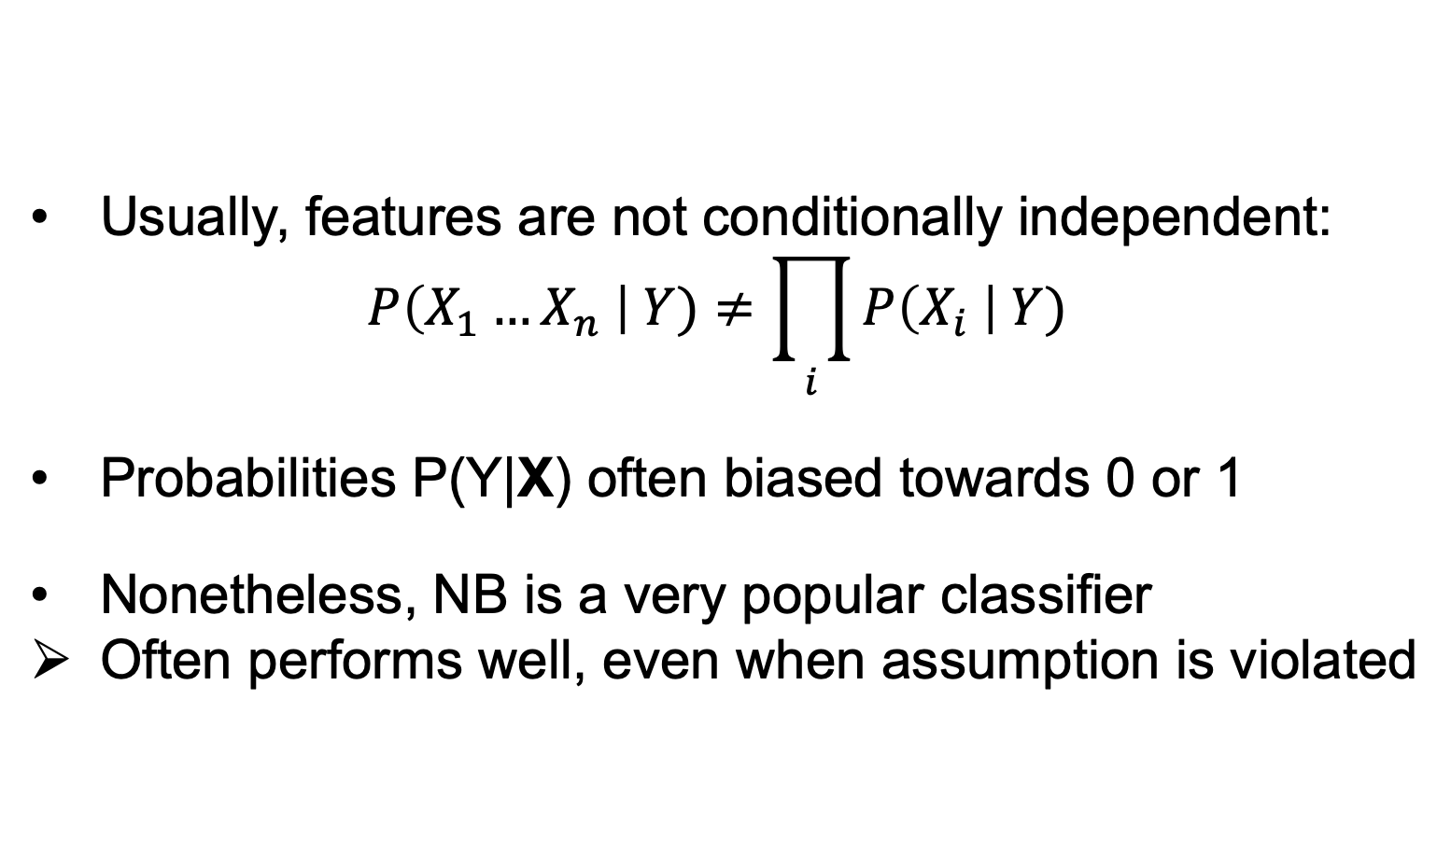
Violating the NB assumption
Usually, features are not conditionally independent:
$$P\left(X_{1}…X_{n} \right| Y)≠\prod_{i}{P\left(X_{i} \right| Y) }$$
Probabilities P(Y|X) often biased towards 0 or 1
Nonetheless, NB is a very popular classifier
Often performs well, even when assumption is violated

Slide 40
Underfitting versus overfitting
All about improving generalization capacity

Slide 41
Splitting the data into
training, validation and test
In order to build a model with good generalization capacity, we have to test it on unseen data
First approach (works well when we have enough data):
50% samples for training
25% samples for validation
25% samples for test
(percentages can vary)

Slide 42
Why not just split the data into
training and test?
Repeatedly using the same split when trying different hyperparameters can “wear out” the test set:
We are overfitting in hyperparameter space!
We obtain a better error estimate by tuning the hyperparameters on a (different) validation set

Slide 43
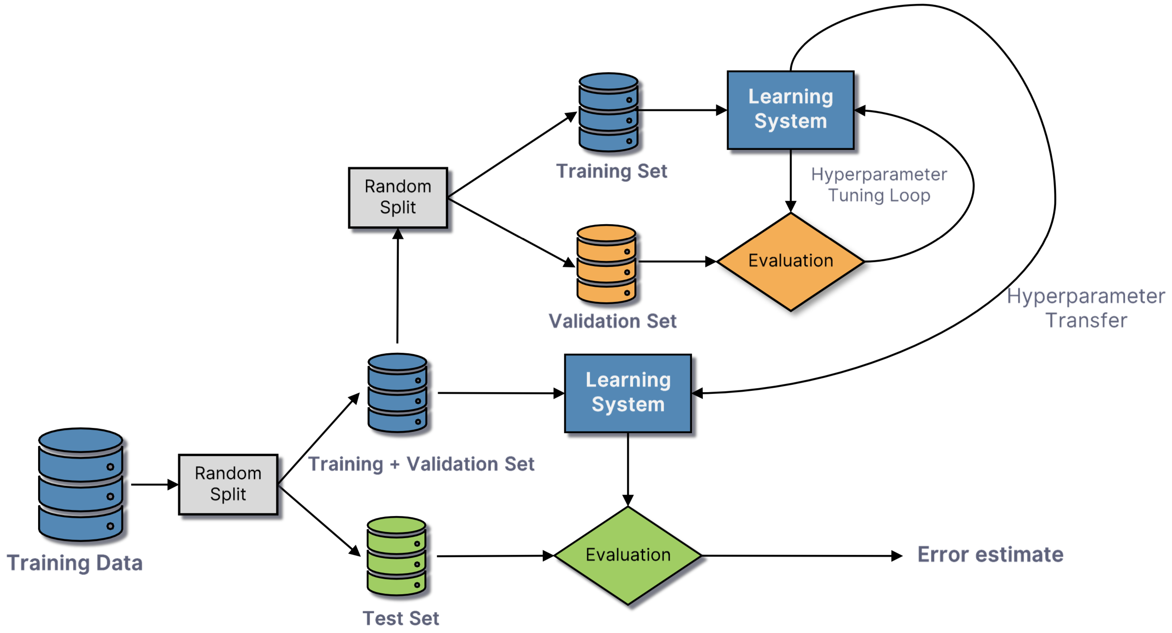
Training, validation, test

Slide 44
Cross-validation
Another approach (works well when we have limited data):
Split the data into k equal parts (folds)
Train on k-1 folds and test on the left out fold
Repeat for k times
Average the results
When the number of folds is equal to the number of samples:
Leave-one-out cross-validation

Slide 45
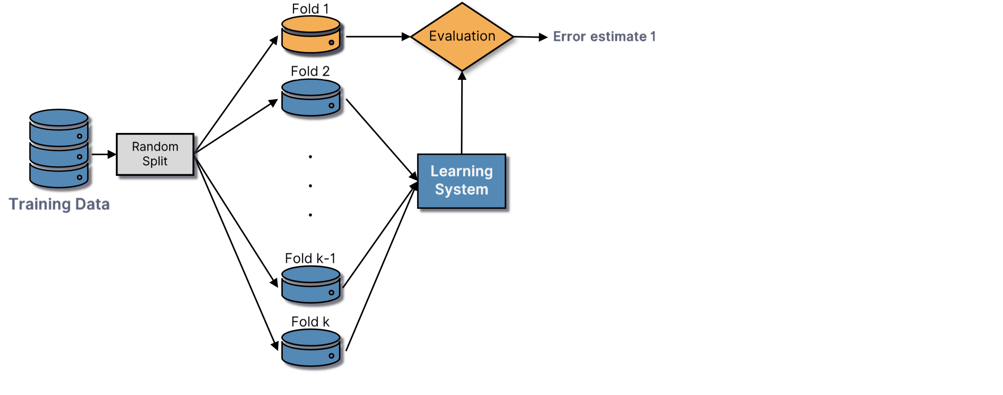
Cross-validation

Slide 46
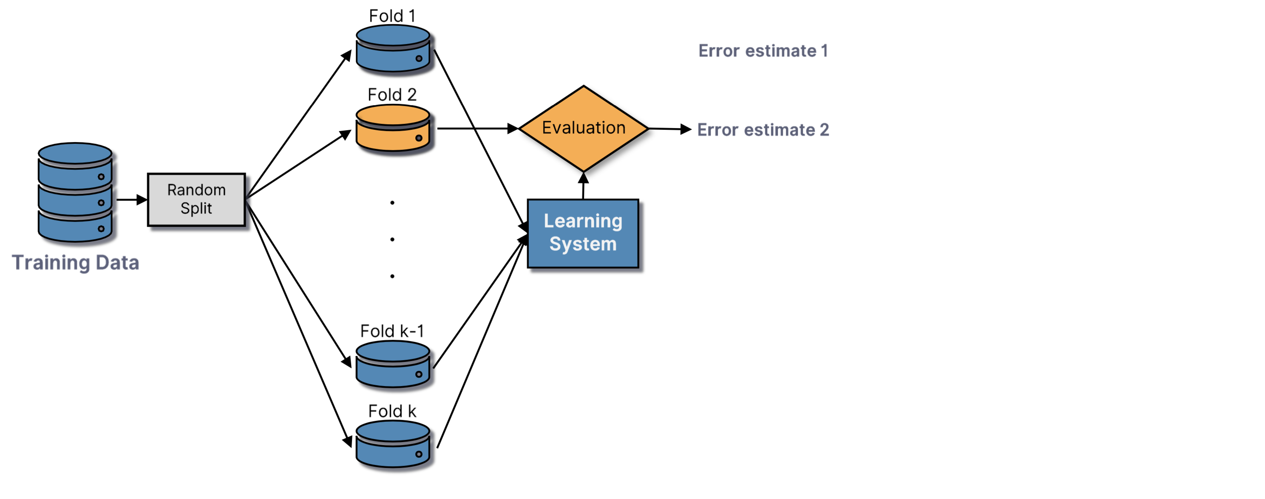
Cross-validation

Slide 47
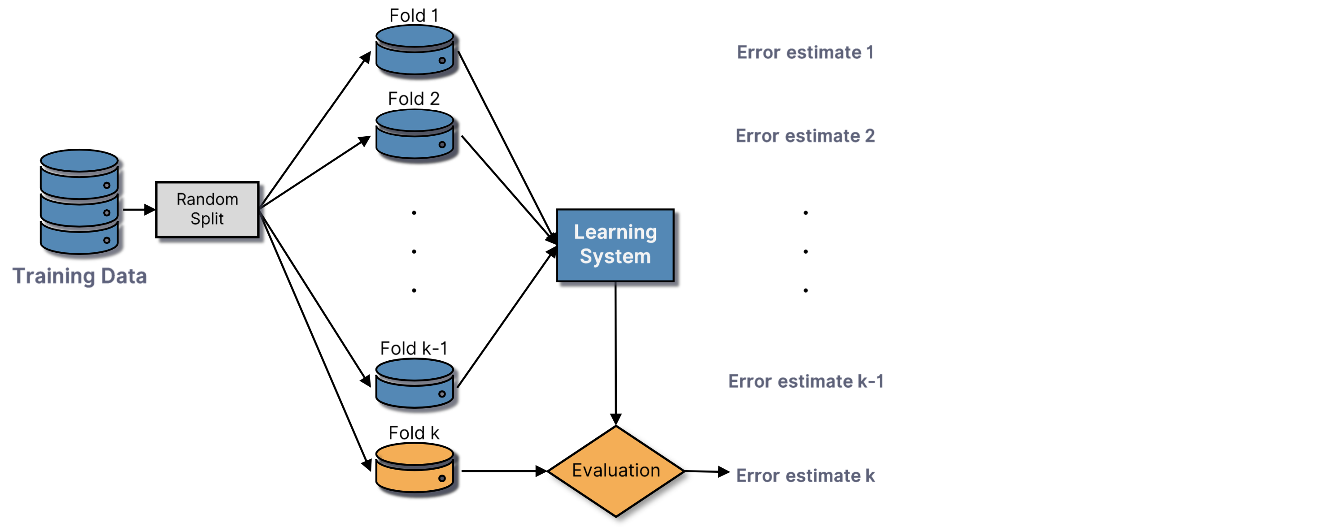
Cross-validation

Slide 48
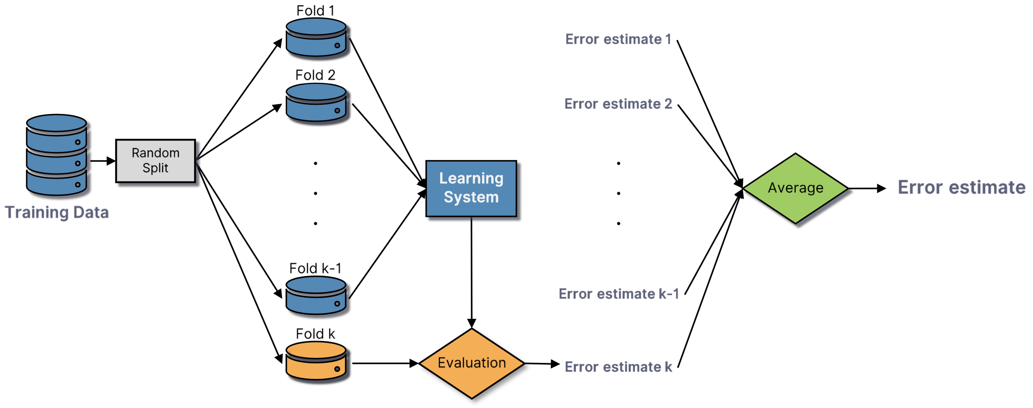
Cross-validation

Slide 49
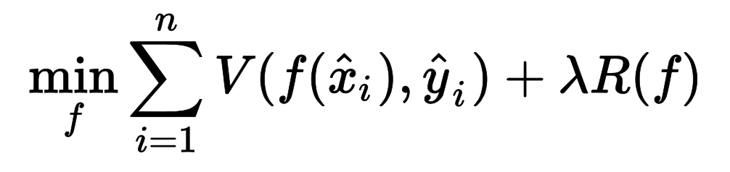
Improving generalization
Early Stopping
Stop the learning process when we notice that the validation error starts to increase
Regularization
Add a penalty term to the loss function to reduce model complexity, by imposing smoothing restrictions or a limit on the weight vector norm:

Slide 50
Performance Evaluation

Slide 51
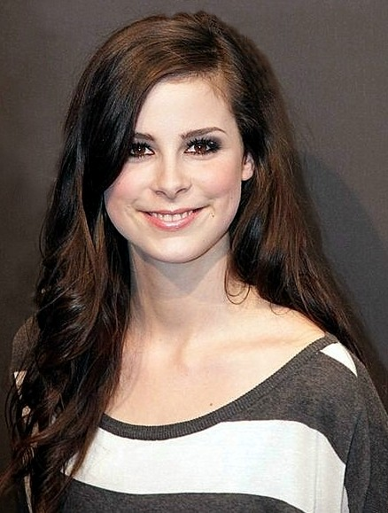
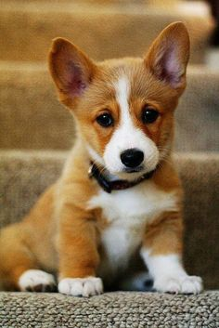
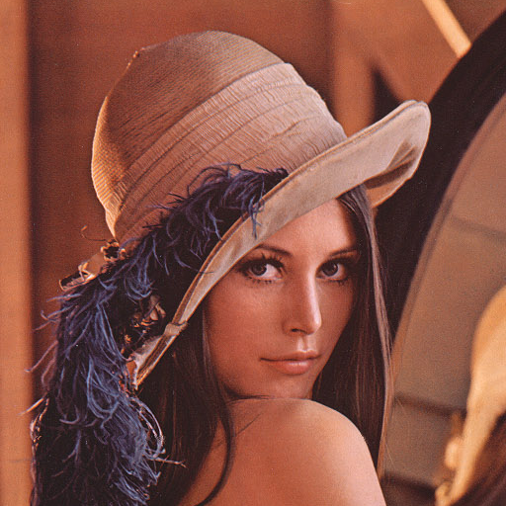
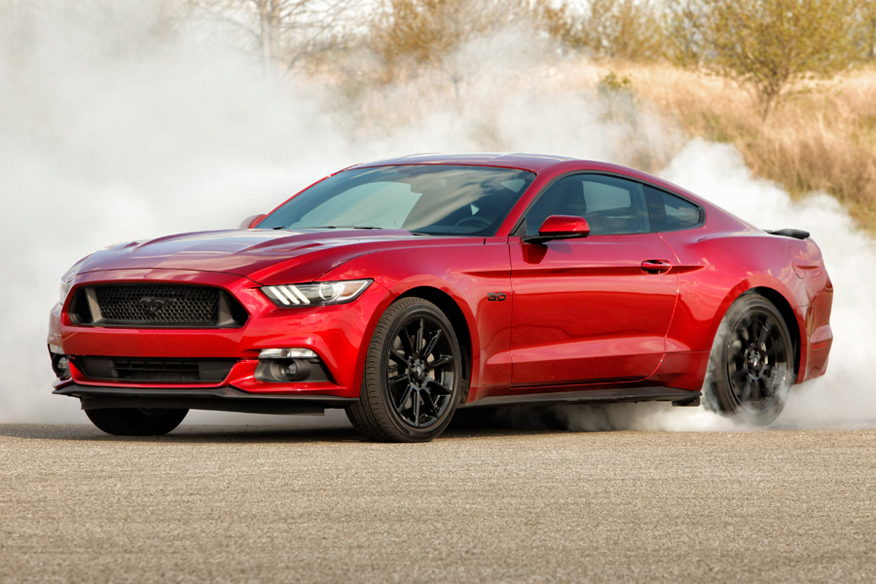
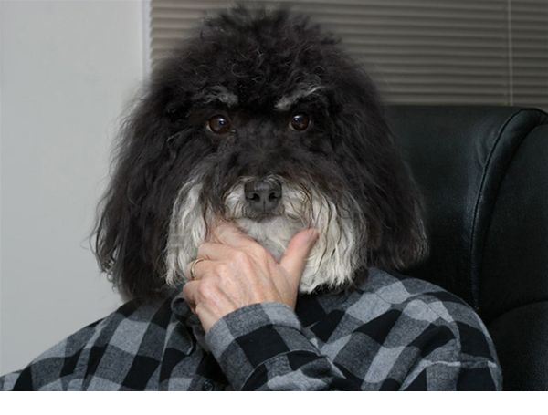
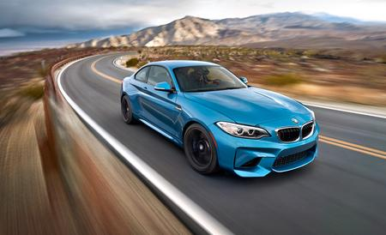
How do we evaluate an ML model?
We measure the accuracy / error on test data:
Accuracy: 4 correct out of 6 = 66.67%
Error: 2 wrong out of 6 = 33.33%
Car?
Person?
Person?
Person?
Dog?
Dog?

Slide 52
How do we evaluate an ML model?
We build the confusion matrix
Accuracy: the sum of the elements from the main diagonal divided by the sum of non-zero components (4/6)
Error: the sum of the elements outside the main diagonal divided by the sum of non-zero components (2/6)
Car?
Person?
Person?
Person?
Dog?
Dog?
Predicted Actual | Car | Dog | Person
Car | 1 | 1 | 0
Dog | 0 | 1 | 1
Person | 0 | 0 | 2

Slide 53

How do we evaluate an ML model?
Confusion matrix in the binary case
Not?
Person?
Person?
Person?
Not?
Not?
 | Predicted YES | Predicted NO
Actual YES | True Positive | False Negative
Actual NO | False Positive | True Negative

Slide 54
How do we evaluate an ML model?
Confusion matrix in the binary case
Not?
Person?
Person?
Person?
Not?
Not?
 | Predicted YES | Predicted NO
Actual YES | 2 | False Negative
Actual NO | False Positive | True Negative

Slide 55
How do we evaluate an ML model?
Confusion matrix in the binary case
Not?
Person?
Person?
Person?
Not?
Not?
 | Predicted YES | Predicted NO
Actual YES | 2 | 1
Actual NO | False Positive | True Negative

Slide 56
How do we evaluate an ML model?
Confusion matrix in the binary case
Not?
Person?
Person?
Person?
Not?
Not?
 | Predicted YES | Predicted NO
Actual YES | 2 | 1
Actual NO | 1 | True Negative

Slide 57
How do we evaluate an ML model?
Confusion matrix in the binary case
Not?
Person?
Person?
Person?
Not?
Not?
 | Predicted YES | Predicted NO
Actual YES | 2 | 1
Actual NO | 1 | 2

Slide 58
How do we evaluate an ML model?
We compute Precision and Recall
Precision = TP / (TP + FP)
= 66.67%
Recall = TP / (TP + FN)
= 66.67%
Not?
Person?
Person?
Person?
Not?
Not?
 | Predicted YES | Predicted NO
Actual YES | 2 | 1
Actual NO | 1 | 2

Slide 59
How do we evaluate an ML model?
We build the Precision-Recall curve
Person?
Not?
Person?
Not?
Person?
Not?

Slide 60
How do we evaluate an ML model?
Precision-Recall curve
1
Recall
0
Precision
1

Slide 61
How do we evaluate an ML model?
Average Precision
1
Recall
AP
0
Precision
1

Slide 62
How do we evaluate an ML model?
We compute the TPR and FPR
TPR = TP / (TP + FP)
= 66.67%
FPR = FP / (FP + TN)
= 33.33%
Not?
Person?
Person?
Person?
Not?
Not?
 | Predicted YES | Predicted NO
Actual YES | 2 | 1
Actual NO | 1 | 2

Slide 63
How do we evaluate an ML model?
ROC (Receiver Operating Characteristic) curve
1
TPR
0
FPR
1

Slide 64
How do we evaluate an ML model?
We compute the AUC (area under the ROC curve)
1
TPR
0
FPR
1

Slide 65
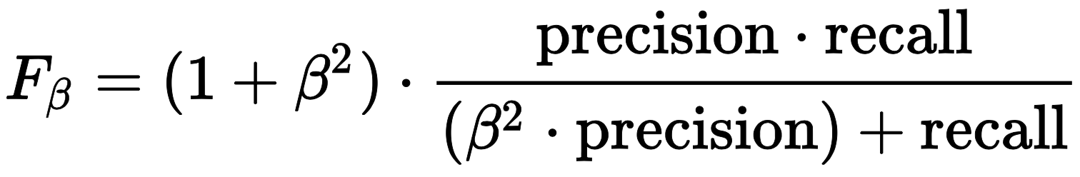
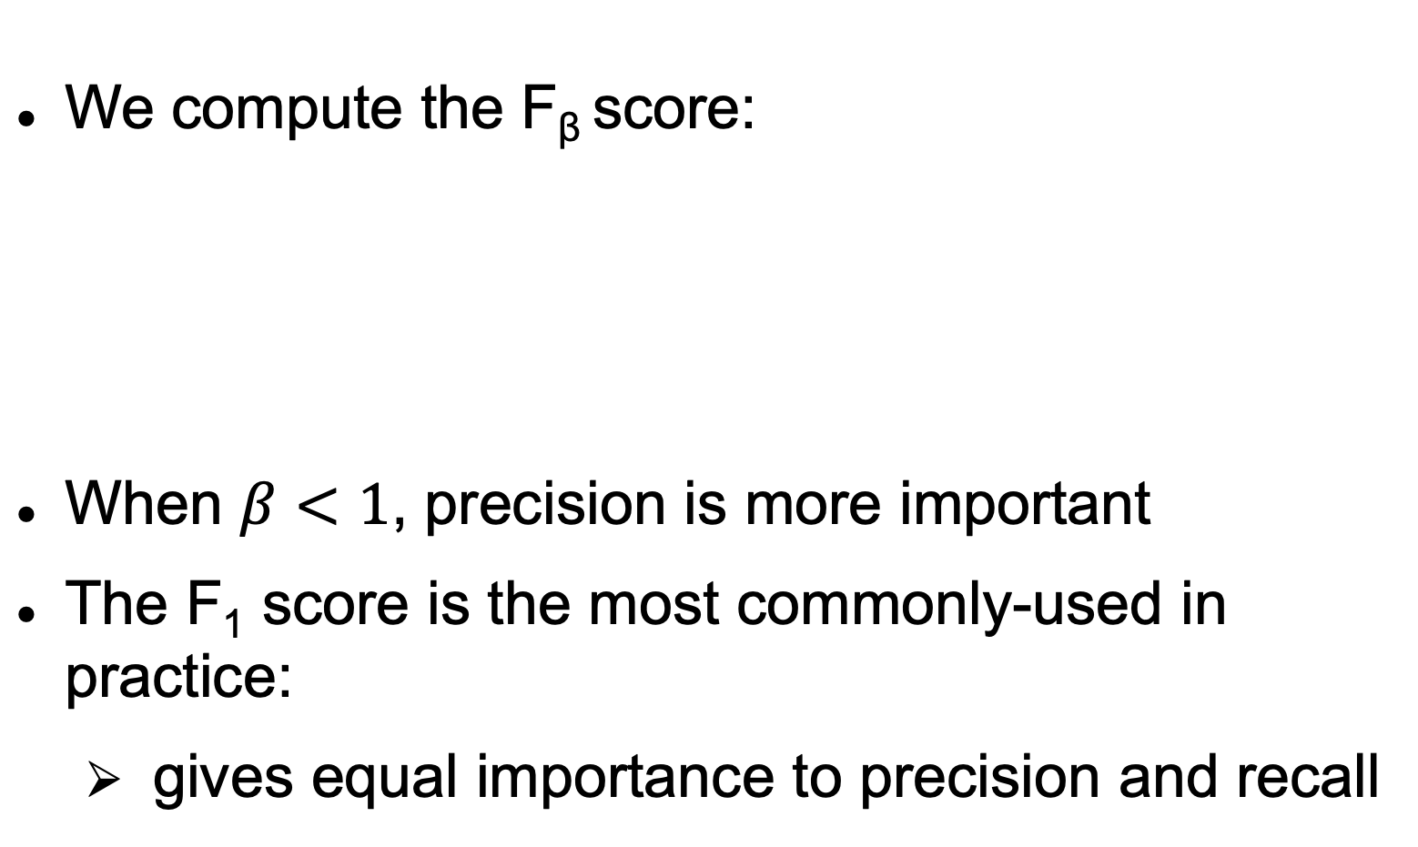
How do we evaluate an ML model?
We compute the F_{β} score:
When $β<1$, precision is more important
The F₁ score is the most commonly-used in practice:
gives equal importance to precision and recall

Slide 66
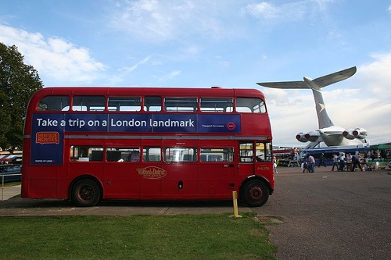
How do we evaluate a detection model?
Intersection over Union (Jaccard index)

Slide 67
How do we evaluate a detection model?
Intersection over Union (Jaccard index)
Correct detection if J(A,B) > 0.5

Slide 68
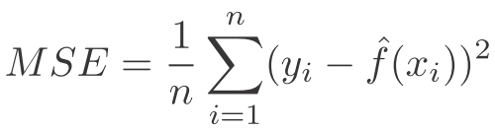
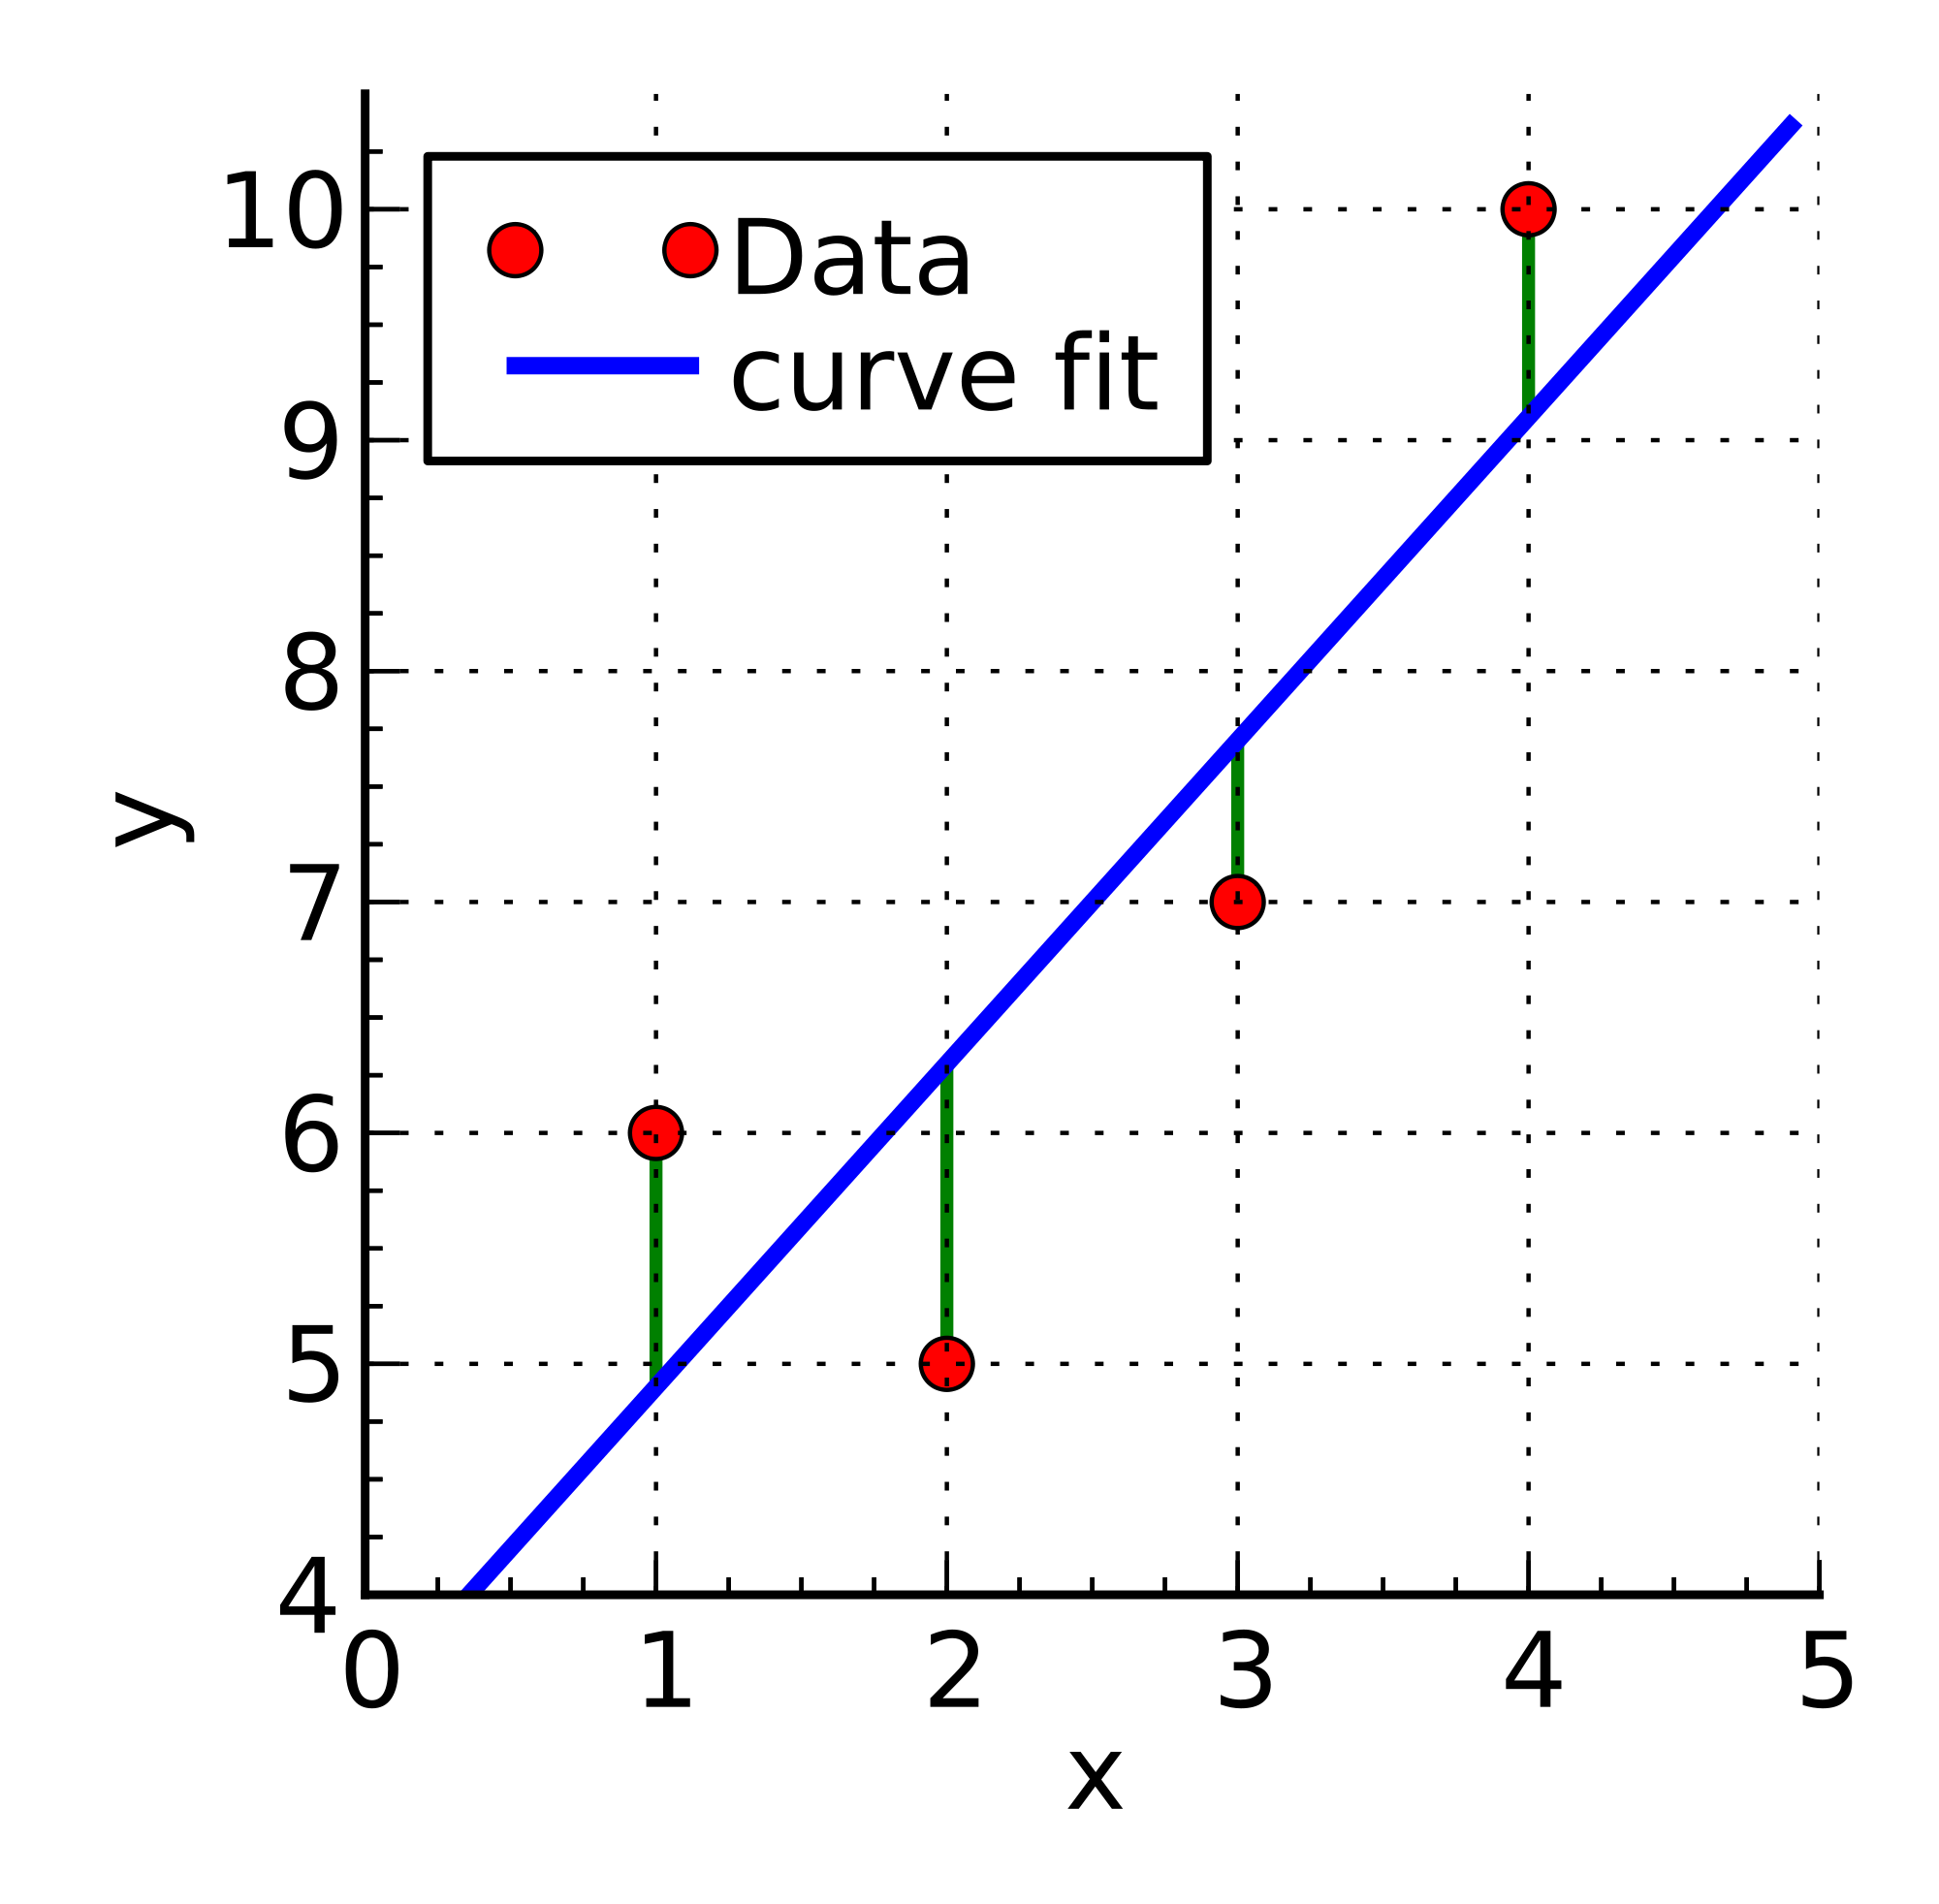
How do we evaluate a regression model?
Mean squared error (MSE)

Slide 69

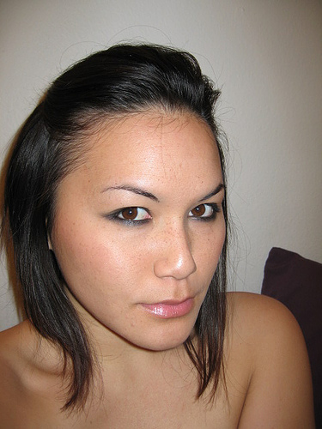
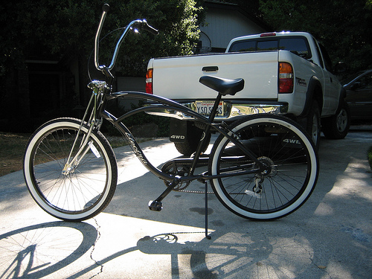
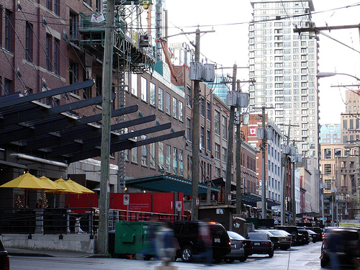

How do we evaluate a regression model?
Order of difficulty according to humans
Order of difficulty predicted by system

Slide 70
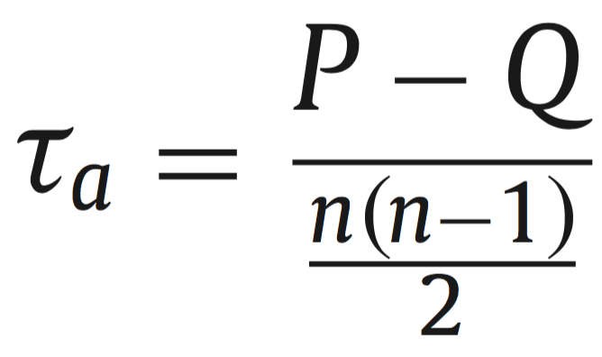
How do we evaluate a regression model?
Kendall Tau correlation:
Ordinal measure based on counting concordant (P) and discordant (Q) pairs:

Slide 71
How do we evaluate a regression model?
Order of difficulty according to humans
Order of difficulty predicted by system

Slide 72
How do we evaluate a regression model?
Order of difficulty according to humans
Order of difficulty predicted by system

Slide 73
How do we evaluate a regression model?
What is the value of Kendall Tau correlation?
P = ?, Q = ?

Slide 74
How do we evaluate a regression model?
What is the value of Kendall Tau correlation?
P = 7, Q = 3, Kendall Tau = (7-3) / 10 = 0.4

Slide 75

In-class demo (if there is time)
Variables:
Y = {does not play football, plays football}
X₁ = {does not watch sports on TV, watches sports on TV}
X₂ = {girl, boy}
Estimate:
$P\left(Y=0\right)$, $P\left(Y=1\right)$
$P\left(X_{1}=0 | Y=0\right)$, $P\left(X_{1}=1 | Y=0\right)$
$P\left(X_{2}=0 | Y=0\right)$, $P\left(X_{2}=1 | Y=0\right)$
$P\left(X_{1}=1 | Y=1\right)$, $P\left(X_{1}=1 | Y=1\right)$
$P\left(X_{2}=1 | Y=1\right)$, $P\left(X_{2}=1 | Y=1\right)$
Prediction:
$$\underset{y}{argmax}{P\left(Y=y\right) P\left({X_{1}=x}_{1} \right| Y=y)P\left({X_{2}=x}_{2} \right| Y=y)}$$

